Slide 1
Can We Predict If A Person Will Be Killed By A Train?
Elliot Ting

Slide 2
The Problem
In 2017, accidents were the 4th leading cause of death in the United States.
Out of these 136,053 deaths, 889 were caused from railroad accidents.
Can’t all of these deaths be preventable?
The investigations cost time and money.

Slide 3
The Question
Can we predict if a person will be killed by a train?

Slide 4
Why is this important?
Saving lives is always important.
There are resource costs associated with investigating what went wrong.
There are environmental costs associated with these investigations.
Investigation requires sections of rail to be closed off.
Goods that were to be transported via rail still have to be transported to their destination somehow (Air, Truck, etc)

Slide 5
Master Dataset
All railroad accidents in the US from 2010-2017
75,485 Entries with 50 Unique Variables
Provided by the Federal Railroad Administration’s Office of Safety Analysis

Slide 6
Cross-Validation Technique Used: TimeSeriesSplit
Due to the time series nature of our data, we could not rely on a regular k fold technique.
If we used a regular k-fold CV, then we would have been ‘peeking’ into the future to train our models.
We would have came to a faulty conclusion that our models generalize better than they actually do.

Slide 7
Unbalanced Classes
In our dataset, 596 entries out of 75,486 resulted in a fatality.
If our models naively guessed that every event would not result in a death, it would achieve 92% accuracy.
We balanced our classes using Random Oversampling
We also choose a performance metric called Area Under Receiving Operator Curve that accounts for False Positives & False Negatives

Slide 8
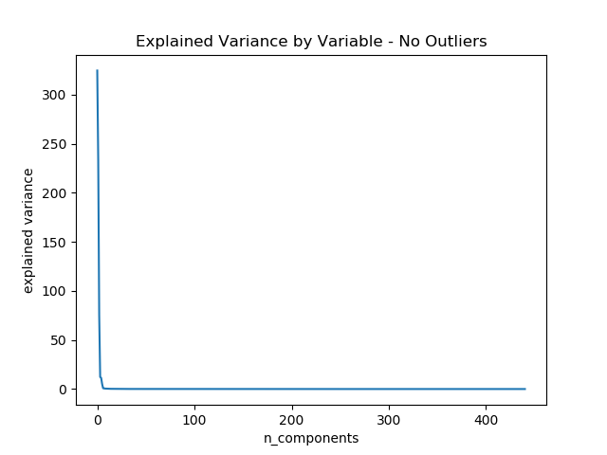
What are the statistically significant variables?

Slide 9
What are the statistically significant variables?
Variable | Explained Variance Ratio
Month of Incident | 48%
Age of Person Reported | 35%
Day of Incident | 11%
Year of Incident - 4 Digits | 2%
Hour of Incident | 2%
Minute of Incident | 1%
Type of Person_A | 0%

Slide 10
What are the possible machine learning methods?
Logistic Regression
Decision Trees
Random Forest Classifiers

Slide 11
Performance Metric: Area Under Receiving Operator Curve
Logistic Regression | Decision Tree | Random Forest
Non PCA'd Data & No Oversampling
0.7416 | 0.7088 | 0.6852
Non PCA'd Data & Oversampling
0.8995 | 0.6732 | 0.7241
PCA'd Data & No Oversampling
0.5000 | 0.5314 | 0.5042
PCA'd Data & Oversampling
0.5746 | 0.5231 | 0.5071

Slide 12
Conclusion
We can predict if a person will be killed by a train

Slide 13
Future Work
We could try to predict not only if a person will be killed by a train, but the location of the event.
Instead of using PCA to reduce the dimensionality of our data, we could try Manifold learning techniques.

